Slide 1

Computer Engineering Department
A.P. Shah Institute of Technology
G.B.Road, Kasarvadavli, Thane(W), Mumbai-400615
UNIVERSITY OF MUMBAI
Academic Year 2021-2022

Slide 2
A Project Report on
Twitter Sentiments Analysis using Machine Learning
Submitted in partial fulfillment of the degree of
Bachelor of Engineering(Sem-7)
in
Computer Engineering
By
Parth B. Shah.(17102035)
Khush M. Shah.(17102033)
Vishnu Ezhuthassan(17102071)
Under the Guidance of
Prof. Jaya D. Gupta.

Slide 3
1.Project Conception and Initiation

Slide 4
1.1 Abstract
Analysis of sentiments is the method of deciding whether the sentiments in the text are positive, negative or neutral. It is also known as material polarity or mining of opinions. The growth and advancement in social media platforms engaged a huge number of users. Social media platforms like twitter where users can post their tweets in 280 characters. Because of the limited number of characters in tweets, it becomes easy for sentiment analysis. On Twitter 550 millions of tweets are posted daily. Twitter also represents all age group people and also a fair representation of gender. Therefore, the sentiment analysis of twitter data becomes somewhat general sentiments of society.

Slide 5
1.2 Objectives
Sentiment analysis can be defined as a process that automates mining of attitudes, opinions, views and emotions from text, speech, tweets and database sources through Natural Language Processing (NLP). Sentiment analysis involves classifying opinions in text into categories like "positive" or "negative" or "neutral". It's also referred to as subjectivity analysis, opinion mining, and appraisal extraction.
So what our application will do?
We’ll train our model on a particular dataset(if we succeed in that, then we’ll try to web scrape data using API).
From that our model will give result as Positive, Negative or Neutral.
This will help in analyzing the emotions of the people in that particular region.
Where can we use this application?
Elections - We can know the sentiments of the people in the region where election is going to happen, people are in favor of which political party? How people are reacting towards their favorite political leader? What are their reaction on the work done by the political workers?, etc.; through this analysis political leaders and party representative can get the information like winning probability of them in that area, what all are the area of improvement people are demanding from them, etc.
Customer Service - Traditionally people use to call customer care for their complaints but, nowadays people tweets about their complaints to the company’s Official Twitter Handle; so if the management of the company wants to know how good their social media service team is serving to the consumers, they can know through twitter sentiments analysis; our application will help them to know whether their customers are positive, negative or neutral about their services.

Slide 6
1.3 Literature Review
Sentiment analysis in the domain of micro-blogging is a relatively new research topic so there is still a lot of room for further research in this area. Decent amount of related prior work has been done on sentiment analysis of user reviews,documents, web blogs/articles and general phrase level sentiment analysis. These differ from twitter mainly because of the limit of 280 characters per tweet which forces the user to express opinion compressed in very short text. The best results reached in sentiment classification use supervised learning techniques such as Naive Bayes and Support Vector Machines, but the manual labelling required for the supervised approach is very expensive. Some work has been done on unsupervised and semi-supervised approaches, and there is a lot of room of improvement. Various researchers testing new features and classification techniques often just compare their results to baseline performance.

Slide 7
1.4 Problem Definition
To find and analyze the emotions of the tweet’s is either positive, negative or neutral. For which we need the datasets containing a huge amount of tweets. On those datasets we’ll be able to train and test our model and try to understand the scenario of different tweets.

Slide 8
1.5 Scope
Manufacturers or developers of the products of the can review their product by analyzing the sentiments of the people. That is how people reacting to their products.
Marketing personal can see how people are reacting to their advertising campaign. They can analyze the sentiments related to this.
Consider another example of movies, where if a movie maker wants to know whether the teaser of the movie is successful in the audience, what kind of the business they can get when it gets launched, etc. The tweets tweeted by the users after watching the trailer helps movie makers analyze/predict the success of the movie. There is an abundant need of analyzing sentiments.

Slide 9
1.6 Technology stack
Python.
Web scrape using twitter’s API.
Natural Language Processing (NLP).
Naive Bayes Classifier.

Slide 10
1.7 Benefits for environment & Society
Manufacturers or developers of the products of the can review their product by analyzing the sentiments of the people. That is how people react to their products.
Marketing personnel can see how people are reacting to their advertising campaign. They can analyze the sentiments related to this.
Political parties can see how their political campaign is running and how people are reacting to it. They can analyze which issue to be raised to not.
Filmmakers can see how people are reacting to their newly released movie, by analyzing the sentiments of the people.

Slide 11
2. Project Design

Slide 12
2.1 Proposed System
As we know that twitter has one of the largest user base in entire world. And it has consumer base of all age groups and gender. It has consumer base studying and working in every domain like art, science, commerce, business, marketing, sales, politics, etc. which helps us to understand and generalize the sentiments of each group.
So twitter is the perfect platform on which the sentiments analysis should be done, it can give a generalize opinion of a particular region.
The main advantage of our system is that it will help to know the sentiments of the people; are they happy, sad or neutral i.e. positive, negative or neutral in that particular region/domain.
We will be using various machine learning algorithm to train and test of our dataset and get maximum amount of accuracy.

Slide 13
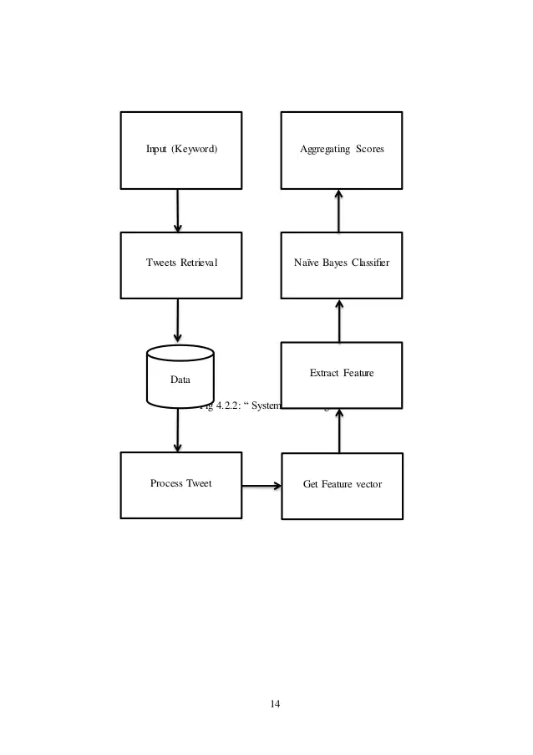
2.2 Design(Flow Of Modules)

Slide 14
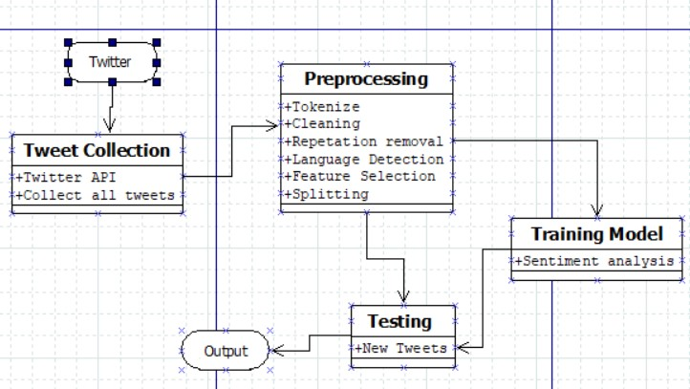
2.3 Class Diagram

Slide 15
2.4 Module-1
Data Gathering :
We have taken a dataset from different websites on which we will try to implement our application.
Pre - Processing :
After collecting the textual data from online freely available datasets, the next step is pre - processing. That is implemented in python. There are several steps involved in pre - processing are as follows :
a. Conversion of uppercase letter to lowercase; e.g. TOPPER to topper.
b. Tokenization : Tokenization is done with the help of installing the NLP (Natural Language Processing) package. It means the removal of Hashtags, and the conversion of text to token. And removing Numbers like(1, 2, 3, 4...) URL and Targets (@) etc.

Slide 16
Module-2
c. Removal of non - English words : Twitter supports many languages but since our project deals with English so, we remove non English words.
d. Emotion Replacement : It is very important for evaluating the Sentiments of the users. Hence, we substitute the emotional terms with their polarity by contrasting them in the dictionary of emotions.
e. Removal of stop words : For sentiments analysis we need to remove the stop words like (a, an, the… etc.) Which does not play any significant role in sentiments analysis.

Slide 17
Module-3
3. Feature Extracting :
The selection of the words which are useful from the tweet of the user is called feature extraction. In feature extraction we extract the aspect from, pre-processed twitter data set.
There are three types of features mainly unigram, bigram, and n-gram feature.
POS i.e. Parts of speech tags like adjective, adverb, verb, and noun is a good indicator of subjectivity and sentiments analysis.
One of the difficult things to interpret is negation which usually changes the polarity of the content.

Slide 18
Module - 4
4. Feature Selection :
For sentiment analysis, appropriate feature selection techniques are used which have a significant role to play for defining relevant attributes and increasing classification (machine learning) accuracy. We’ll use NLP i.e. Natural Language Processing.

Slide 19
2.5 References
Evolutionary Machine Learning Techniques: Algorithms and Applications (Algorithms for Intelligent Systems) by Seyedali Mirjalili, Hossam Faris, Ibrahim Alijarah.
Sentiment Analysis Using Support Vector Machine 1Aamera Z. H. Khan, 2Dr. Mohammad Atique, 3Dr. V. M. Thakare in International Journal of Advanced Research in Computer Science and Software Engineering(http://ijarcsse.com/Before_August_2017/docs/papers/Spe cial_Issue/ITSD2015/25.)
Twitter Sentiment Analysis Using Support Vector Machine and K-NN Classifiers International Journal of Scientific and Research Publications(http://www.ijsrp.org/research-paper1018.php?rp=P827862)
SENTIMENT ANALYSIS OF TWEETS USING SUPPORT VECTOR MACHINE Suman Rani1 , Jaswinder Singh Suman Rani et al, International Journal of Computer Science and Mobile Applications, Vol.5 Issue. 10, October- 2017, pg. 83-91
Sentiment Analysis using Maximum Entropy Algorithm in Big Data Durgesh Patel , Sakshi Saxena , Toran Verma, International Journal of Innovative Research in Science, Engineering and Technology(http://www.ijirset.com/upload/2016/may/246_49_Sentim ent.pdf)
International Research Journal of Engineering and Technology (IRJET) Volume: 03 Issue: 08 | Aug-2016 www.irjet.net, Sentiment Analysis Using SVM and Maximum Entropy Snehal L. Rathod, Sachin N.Deshmukh
International Journal of Innovative Technology and Exploring Engineering (IJITEE) ISSN: 2278-3075, Volume-8 Issue-8 June, 2019, Sentiment Analysis Using Naïve Bayes Classifier Sentiment Analysis Using Naïve Bayes Classifier.

Slide 20
3.Planning for next semester

Slide 21
Planning
As of now we are trying to execute on the dataset which we have, in that we are trying to remove all the non - english words, converting uppercase characters to lowercase, removing all the hash and hashtags, etc. And trying to increase the accuracy of the model.
After that, we will try to web scrape the data using Twitter API and try to implement our application.
We’ll try to make our application work, in niche field of different domains.
We will try to create GUI for our application, which will be user friendly and has smooth User Interface.

Slide 22
Thank You

